Slide 1
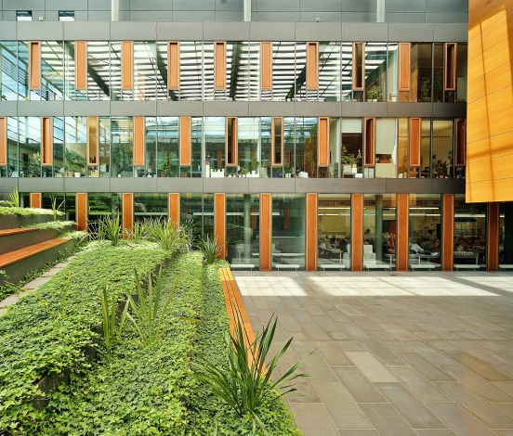
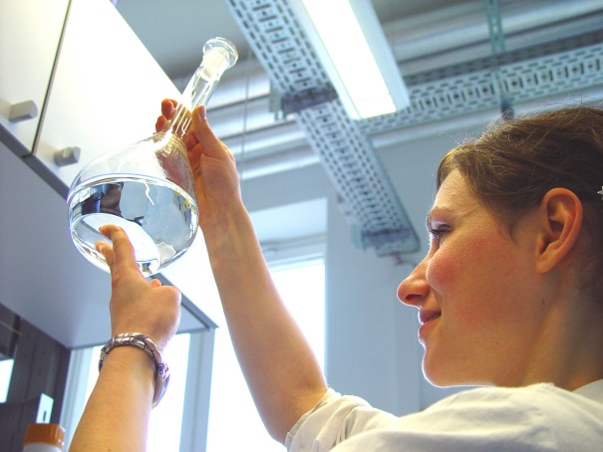
TU Dresden: University of Excellence

Slide 2
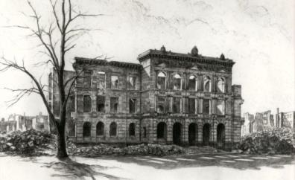
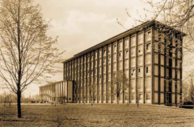
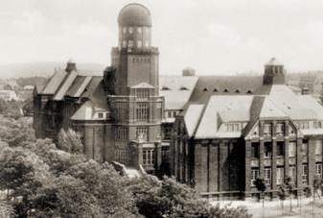
190 Years of History
1828 founded as a technical school
1890 renamed “Royal Saxon Technical College“ (TH)
1945 largely destroyed during World War 2
1946 reopening of TH Dresden
1961 status of a University of Technology (TU)
1990 new faculties, comprehensive range of disciplines
2012 University of Excellence

Slide 3
Facts & Figures
the only technical comprehensive university (Volluniversität) in Germany
Students (WS 2017/18): 33,506
international students: 4,739 from 125 nations
first-year students: 7,808
study programmes: 122
many cooperations with universities worldwide
employees: approx. 8,200 (2017) of whom financed by third-party funds: approx. 3,540
overall budget in 2017: 528,5 million Euros of which third-party funds: 257,7 million Euros

Slide 4
Five Schools – 18 Faculties
School of Civil and Environmental Engineering
Architecture
Civil Engineering
Environmental Sciences
Transportation and Traffic Science
Business and Economics
School of Medicine
Faculty of Medicine
School of Science
Faculty of Biology
Faculty of Chemistry and Food Chemistry,
Faculty of Mathematics
Faculty of Physics
Faculty of Psychology
School of Engineering Sciences
Faculty of Electrical and Computer Engineering
Faculty of Computer Science
Faculty of Mechanical Engineering
School of Humanities and Social Sciences
Education
Faculty of Law
Arts, Humanities and Social Sciences
Linguistics, Literature and Cultural Studies

Slide 5
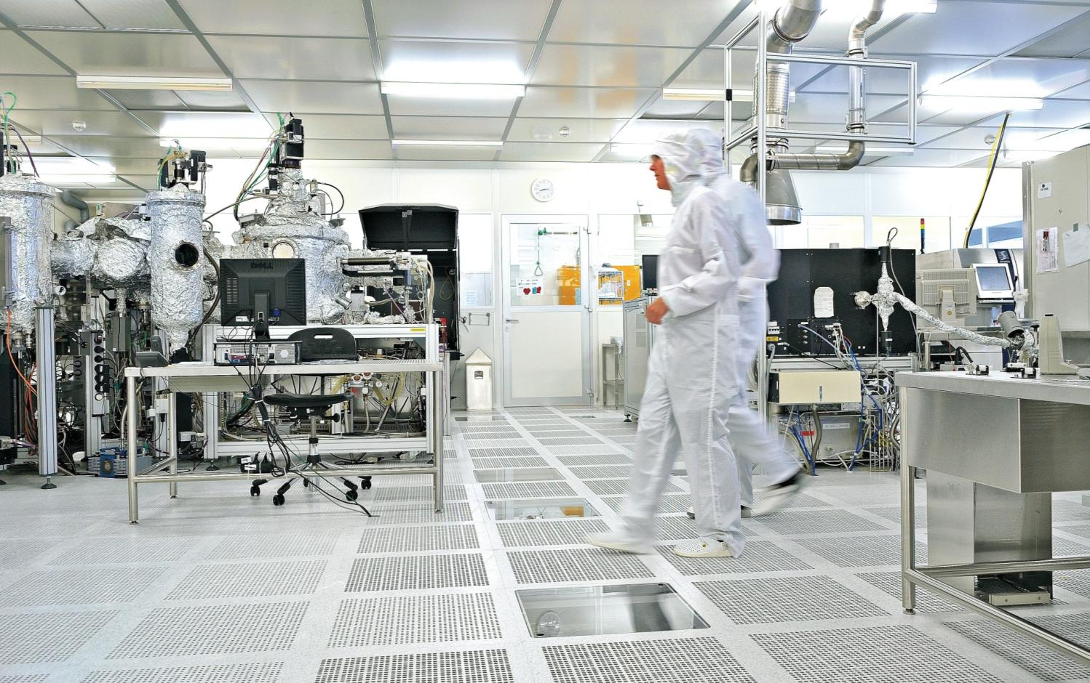
Five Research Priority Areas
Health Sciences, Biomedicine and Bioengineering
Information Technologies and Microelectronics
Smart Materials and Structures
Energy, Mobility and Environment
Culture and Societal Change

Slide 6
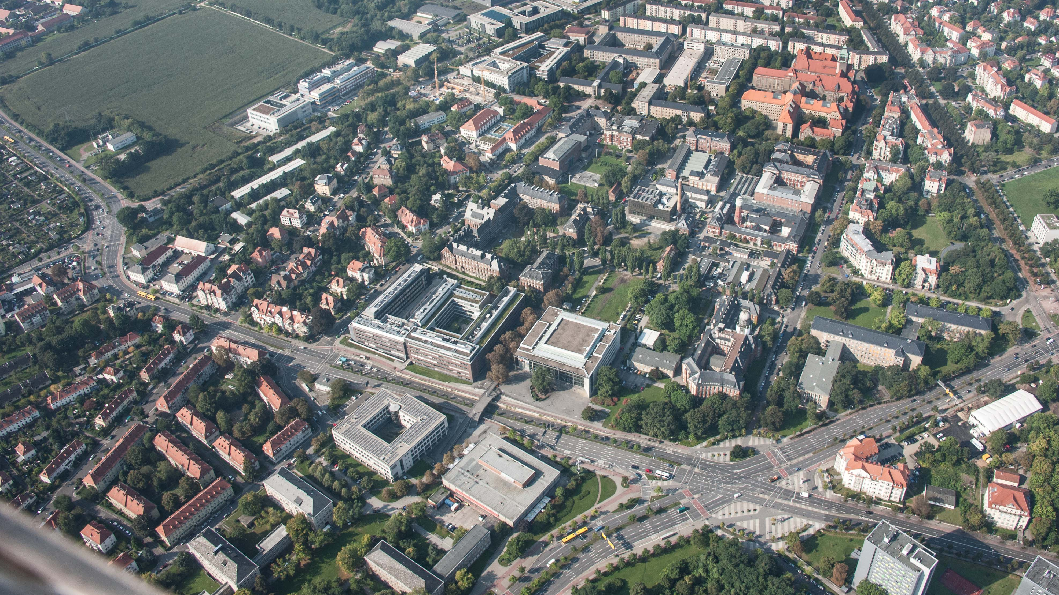
The Campus Today

